Slide 1
Angular 4 - ASP.NET Core
01-Apr-18 | Start
Appendix
Online

Slide 2
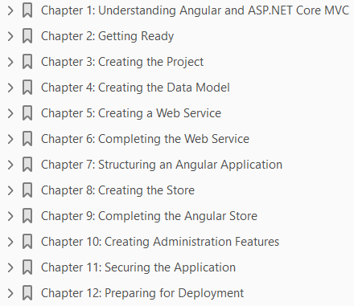
Angular 4
Ch | Date
1 | 01-Apr-18
2 | 03-Apr-18
3
4
5
6
7
8
Essential Angular for ASP.NET Core MVC 2017

Slide 3
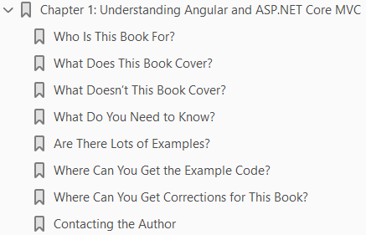
Understanding Angular and ASP.NET Core
1

Slide 4
Intro
This book is about using Angular and ASP.NET Core MVC together to build rich applications.
Individually, each of these frameworks is powerful and feature-rich, but using them together combines the dynamic flexibility of Angular with the solid infrastructure of ASP.NET Core MVC.

Slide 5
Who Is This Book For?
This book is for ASP.NET Core MVC developers who want to add Angular to their projects but don’t know where to start.
Angular is a complex framework that can be overwhelming to learn, and this book provides a solid foundation by using ASP.NET Core MVC to support an Angular application.
By the end of this book, you will understand how ASP.NET Core MVC and Angular can work together and will have gained a basic understanding of how Angular development works.

Slide 6
What Does This Book Cover?
This book explains how to use Angular in an ASP.NET Core MVC project.
I demonstrate how to create a Visual Studio or Visual Studio Code project that contains Angular and ASP.NET Core MVC and show you how to get them working together.
I show you how to use Entity Framework Core to store the application data and ASP.NET Core Identity to authenticate and authorize users.
Each ASP.NET Core package adds its complexities, and I show you how these can be managed to deliver functionality to Angular.
This book also introduces Angular development, focusing on just those features that are required by most applications.
I explain how Angular applications work, how to structure an Angular application, and how individual building blocks can collaborate to create complex features.
The examples are based around SportsStore, which will be familiar if you have read any of my other books. SportsStore is a fictional online store that contains the features that most projects need.
The SportsStore examples in this book have been adapted so that I can highlight problems between Angular and ASP.NET Core MVC and explain how to solve them.

Slide 7
What Doesn’t This Book Cover?
This book is not a deep-dive into Angular or ASP.NET Core MVC.
I assume you are already familiar with C# and ASP.NET Core MVC development, and I describe only the essential Angular features.
I have written other books that provide the deep-dive for each framework.
If you are unfamiliar with ASP.NET Core MVC development, then you should read Pro ASP.NET Core MVC before this book.
Once you have mastered the basics of Angular development, then Pro Angular provides a comprehensive tour of Angular features.

Slide 8
What Do You Need to Know?
Before reading this book, you should have a working knowledge of ASP.NET Core MVC development and have a good understanding of JavaScript, HTML, and CSS.

Slide 9
Are There Lots of Examples?

Slide 10
Where Can You Get the Example Code?

Slide 11
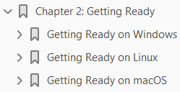
Getting Ready
2

Slide 12
Intro
In this chapter, I explain how to set up the tools and packages required for Angular and ASP.NET Core MVC development.
There are instructions for Windows, Linux, and macOS, which are the three operating systems that can be used for .NET Core projects.
For quick reference, Table 2-1 lists the packages and explains their purpose.
Follow the instructions for your preferred operating system to install the tools that are required for the rest of this book.

Slide 13
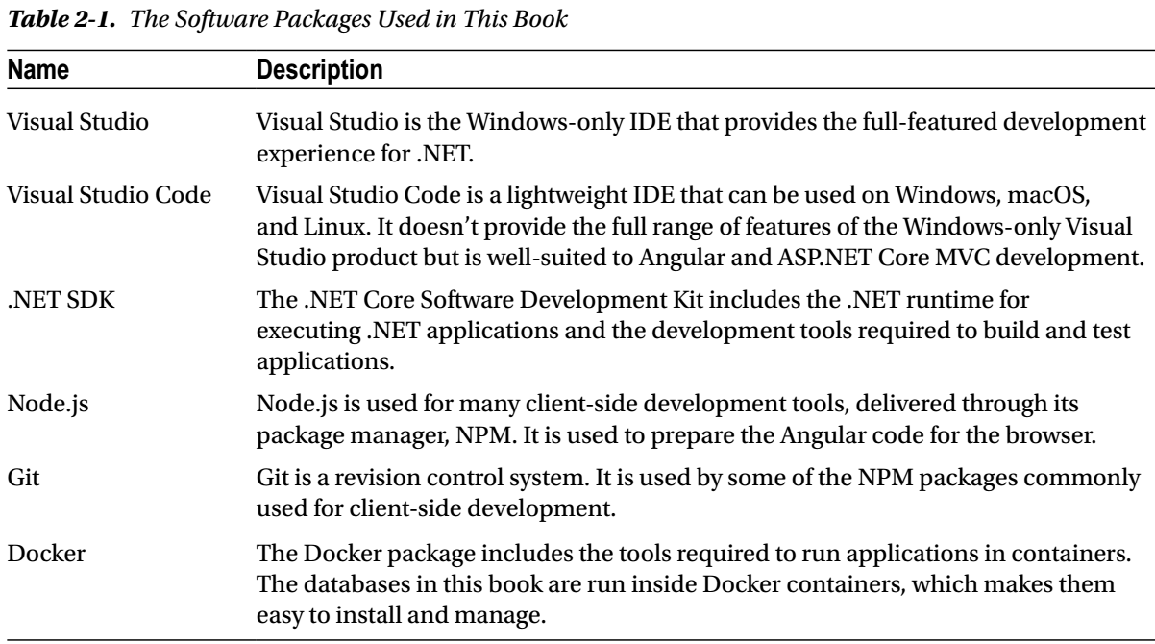
Table 2-1

Slide 14
Getting Ready on Windows
The following sections describe the setup required for Windows.
All the tools used are available for free, although some are offered in commercial versions with additional features (but these are not needed for the examples in this book).
If you are using Windows, you can use Visual Studio, which is the traditional IDE for .NET projects, or Visual Studio Code, which offers a lighter-weight alternative.

Slide 15
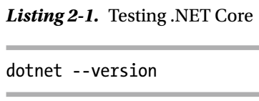
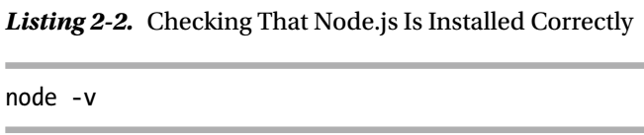
Installing .NET Core
The .NET Core Software Development Kit (SDK) includes the runtime and development tools needed to start the development project and perform database operations.
To install the .NET Core SDK on Windows, download the installer from https://www.microsoft.com/net/download/core and select the 64-bit installer for the .NET Core SDK.
Once the install process is complete, open a new PowerShell command prompt and run the command shown in Listing 2-1 to check that .NET Core is working.
The output from this command will display the latest version of the .NET Core runtime that is installed.
The NPM package manager is used to download and install Node packages.
Adding Node.js to the PATH ensures that you can use the Node.js runtime at the command prompt just by typing node.
Once you have completed the installation, open a new command prompt and run the command shown in Listing 2-2.

Slide 16
Installing Node.js
Node.js is a runtime for server-side JavaScript applications and has become a popular platform for development tools.
In this book, Node.js is used by the Angular build tools to compile and prepare the code that ASP.NET Core MVC will send to the browser.
It is important that you download the same version of Node.js that I use throughout this book.
Although Node.js is relatively stable, there are still breaking API changes from time to time, and they may stop the examples from working.
To install Node.js, download and run the installer from https://nodejs.org/dist/ v6.10.3/node-v6.10.3-x64.msi.
This is the installer for version 6.10.3. You may prefer more recent releases for your projects, but you should stick with the 6.10.3 release for the rest of this book.
Run the installer and ensure that the npm package manager and Add to PATH options are selected, as shown in Figure 2-1.

Slide 17
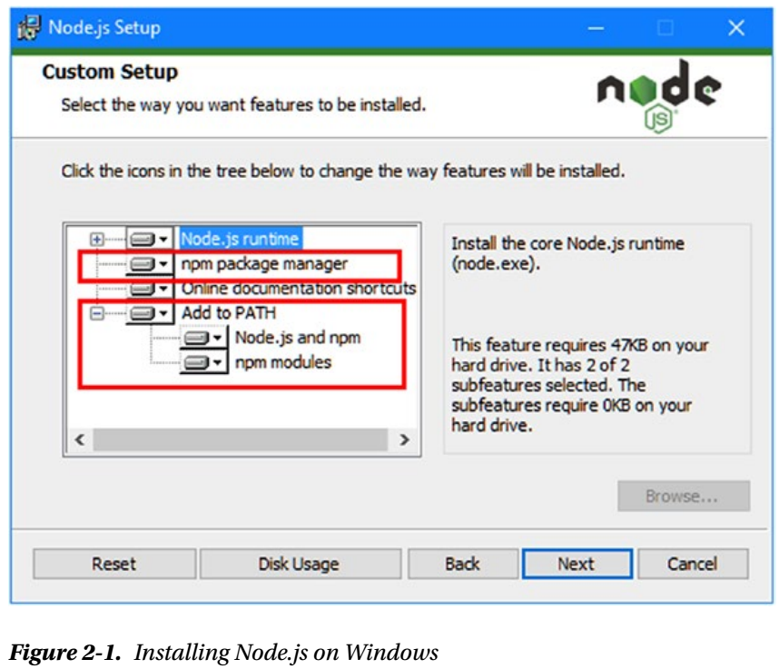
Figure 2-1

Slide 18
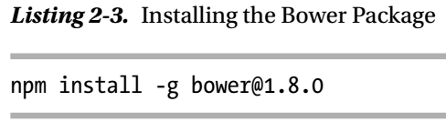
Installing Bower
Once you have installed Node, run the command shown in Listing 2-3 to install the Bower package, which is used to manage client-side packages.

Slide 19
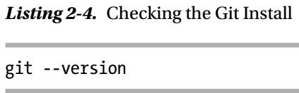
Installing Git
The Git revision control tool is required to download the client-side packages used by the Bower package installed in the previous section.
Download and run the installer from https://git-scm.com/downloads.
When the installation is complete, open a new command prompt and run the command in Listing 2-4 to check that Git is installed and working properly.

Slide 20
Installing Docker
Docker is available in Community and Enterprise editions, the difference being the support and certifications offered for the Enterprise edition.
Both editions provide the same set of core features, and I use the free Docker Community edition throughout this book.
Go to https://store.docker.com/editions/community/docker-ce-desktop-windows, click the Get Docker CE for Windows (stable) link, and run the installer that is downloaded.
Docker will start automatically when the installation is complete.
You may be prompted to enable Hyper-V, as shown in Figure 2-2. Click the Ok button.

Slide 21
Installing Visual Studio 2017

Slide 22
Installing Visual Studio Code

Slide 23
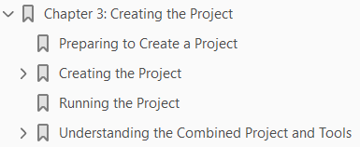
Creating the Project
3
Chapter Updated Content

Slide 24
Intro
In this chapter, I show you how to create a project that contains ASP.NET Core MVC and Angular applications, which means both parts of the project can be developed using Visual Studio or Visual Studio Code.
This project forms the foundation for the rest of this book, as I explain how to use Angular and ASP.NET Core MVC to create a rich web application.
Table 3-1 puts the combined project in context.

Slide 25
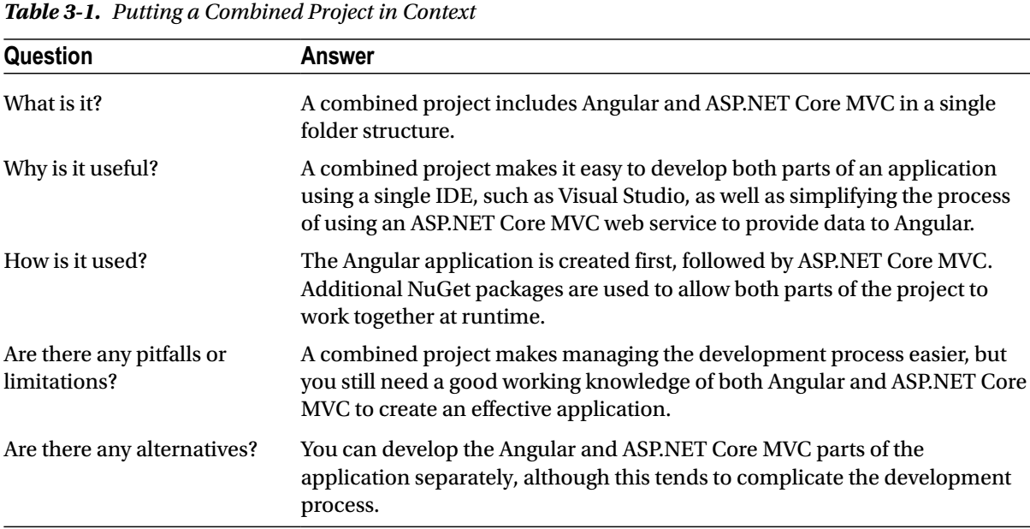
Table 3-1

Slide 26
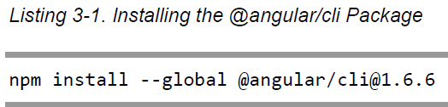
Preparing to Create a Project
There are several different ways to create a project that combines Angular and ASP.NET Core MVC.
The approach that I use in this book relies on the @angular/cli package, used in conjunction with the .NET tools for creating a new MVC project.
The @angular/cli package provides a command-line interface that simplifies the process of creating and working with a new Angular project.
During development, the Angular code is compiled, packaged, and delivered to the browser using webpack, a popular tool for creating JavaScript bundles that contain only the code required to run a project.
To create a project that combines Angular and ASP.NET Core MVC, I start with @angular/cli and access he underlying webpack configuration, which can then be used to integrate the Angular tools and libraries into the ASP.NET Core project.
To start this process, open a new command prompt and run the command in Listing 3-1 to install the @angular/cli package. If you are using Linux or macOS, you may need to use sudo to run this command.
This command takes a while to run because the package has a lot of dependencies, all of which have to be downloaded and installed.

Slide 27
USING THE DOTNET NEW ANGULAR COMMAND
Microsoft provides a template that can be used to create a similar project structure (which you can use by running dotnet new angular at the command line).
The process I use in this chapter is more manual, but it means you will understand how the different building blocks fit together and have a better idea of where to look when you don’t get the results you expect.
Once you are familiar with how Angular and ASP.NET Core MVC can work together, using this template is perfectly reasonable, with the caveat that you are unable to specify the versions of ASP.NET Core MVC and Angular that are used in the project.

Slide 28
Creating a Project
The process for creating a combined Angular and ASP.NET Core MVC project requires careful attention: both development platforms have their tools and conventions, and getting them to work together requires a specific set of steps to be performed in order.
In the sections that follow, I walk through the process and explain each step.
You must follow each step exactly as shown, without missing a step or changing the order.
If you get stuck, then you can download a ready-made project from the source code repository, which is linked from the Apress.com page for this book.

Slide 29
Creating the Angular Part of the Project
The first step is to create a new Angular project, which is done using the @angular/cli package installed in Listing 3-1.
Open a new command prompt, navigate to the folder where you keep your development projects and run the commands shown in Listing 3-2.
The ng command is provided by the @angular/cli package, and ng new creates a new Angular project.
The arguments that start with --skip tell @angular/cli not to perform some of the standard setup steps that are usually included in projects, and the --dir argument specifies the name of the folder that will contain the source code for the Angular application.
The SportsStore folder will contain the complete project - including the ASP.NET Core MVC part of the application - and the Angular code lives in a folder called ClientApp.
The ng new command in Listing 3-2 creates a folder called SportsStore that contains the tools and configuration files for an Angular project, along with some placeholder code so that the tools and project structure can be tested.
The rest of the setup is performed inside the project folder, so run the command shown in Listing 3-3 to change the working directory and rename the folder that contains the client-side part of the application.

Slide 30
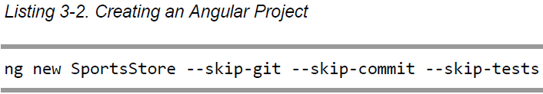
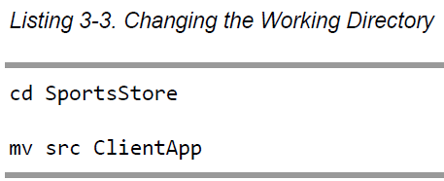
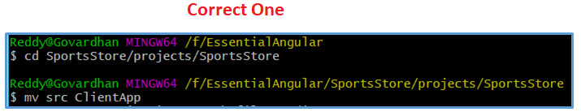
Listing 3-2 || 3-3

Slide 31
NPM Packages
Getting the Angular tools to work with the .NET tools requires additional NPM packages.
Run the commands shown in Listing 3-4 to install these packages.
Microsoft provides some of these NPM packages, and they are used to set up and run the Angular development tools inside the ASP.NET Core runtime.
These packages work directly with webpack, which is usually hidden when working with projects created using @angular/cli.
Open the .angular-cli.json file and change the configuration setting shown in Listing 3-5 to ensure that the project settings reflect the mv command from Listing 3-3.

Slide 32
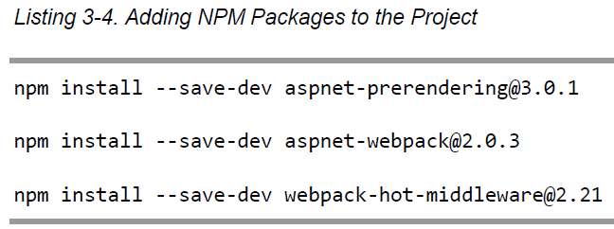
Listing 3-4

Slide 33
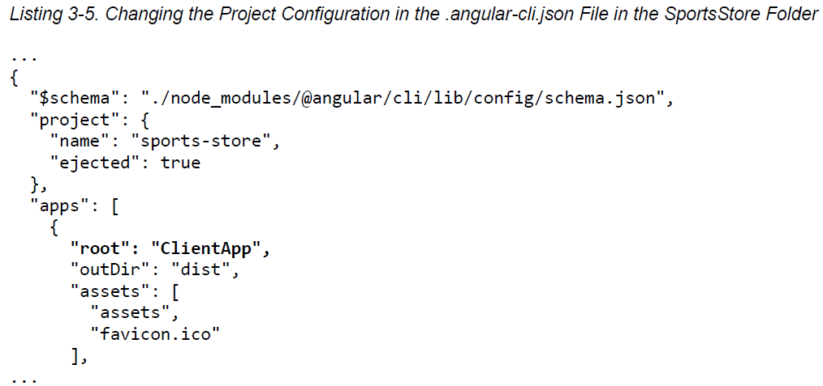
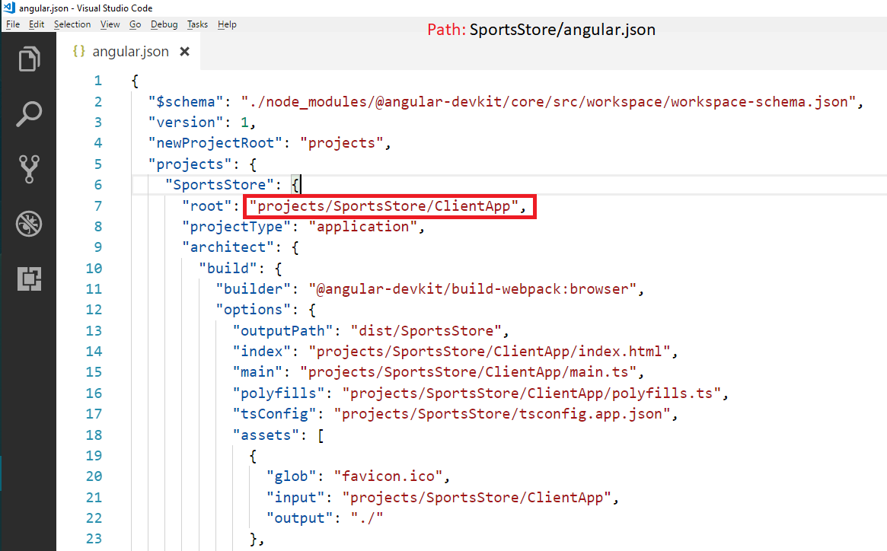
Listing 3-5

Slide 34
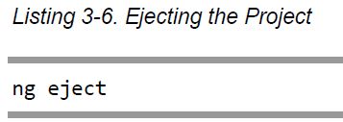
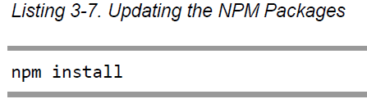
Ejection
Run the command shown in Listing 3-6 in the SportsStore folder to create a webpack configuration file that can be used to build and run the project, a process known as ejecting the project from @angular/cli.
The ejection process updates the package.json file, which NPM uses to keep track of the packages used by the project.
In some cases, the ejection process will add additional NPM packages to the project.json file, so run the command shown in Listing 3-7 to ensure that any new packages are downloaded and installed.
Command Removed

Slide 35
Creating the ASP.NET Core MVC Part of the Project
Once the Angular project has been set up, the next step is to create an MVC project in the same SportsStore folder.
Run the command shown in Listing 3-8 in the SportsStore folder to create a basic MVC project.
Run the command shown in Listing 3-9 in the SportsStore folder to add a Microsoft package to the project.
This NuGet package is the .NET counterpart to the NPM packages installed earlier and is used to integrate the Angular tools into Visual Studio.
The application will be stored using Microsoft SQL Server and accessed using Entity Framework Core.
The meta-package that sets up ASP.NET Core includes the main Entity Framework Core packages but there is one addition that must be made manually.
Open the project using Visual Studio or Visual Studio Code.
If you are using Visual Studio, then select File > Open > Project/Solution, navigate to the SportsStore folder, and select the SportsStore.csproj file.
To edit the NuGet packages, right-click the SportsStore project item in the Solution Explorer, select Edit SportsStore.csproj from the pop-up menu, and make the changes shown in Listing 3-10.
If you are using Visual Studio Code, open the SportsStore project, click SportsStore.csproj in the file list to open the file for editing, and make the changes shown in Listing 3-10.

Slide 36
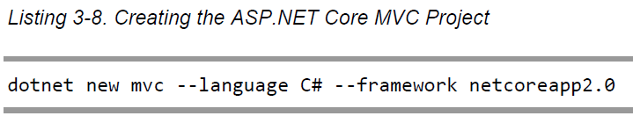
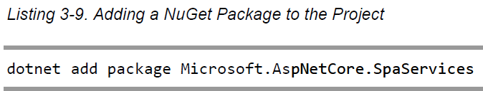
Listing 3-8 || 3-9

Slide 37
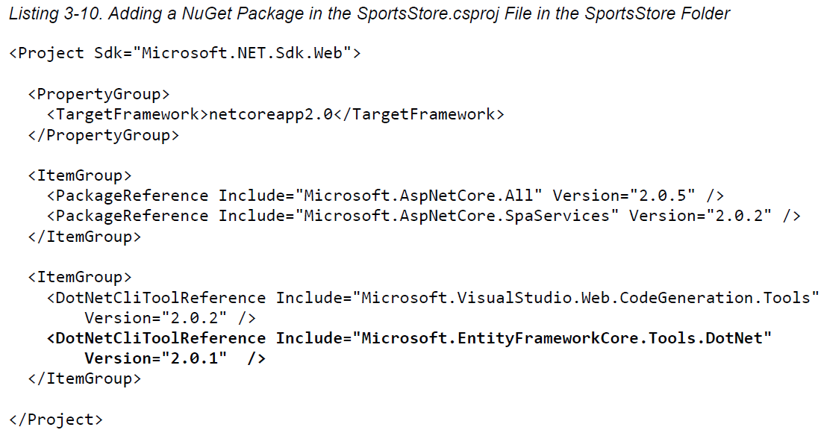
Listing 3-10

Slide 38
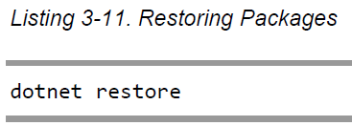
Entity Framework Core
The package in the Listing 3-10 provides the command-line tools for working with Entity Framework Core.
If you are using Visual Studio, the new packages will be downloaded when you save the SportsStore.csproj file.
If you are using Visual Studio Code, use a command prompt to run the command shown in Listing 3-11 in the SportsStore folder.

Slide 39
Configuring the Project
Now that the project foundation is in place, it is time to configure the different parts of the application to work together.

Slide 40
Preparing the Project ( Visual Studio)
If you are using Visual Studio, select File ➤ Open Project/Solution, navigate to the SportsStore folder, and select the SportsStore.csproj file.
Select File ➤ Save All and save the SportsStore.sln file, which you can use to open the project in the future.
Select Project ➤ SportsStore Properties, navigate to the Debug section of the options window, and ensure that IIS Express is selected for the Launch field, as shown in Figure 3-1.
Ensure that the Launch URL button is selected and enter http://localhost:5000 in the App URL field, as shown in Figure 3-1.
Finally, click the Add button to create an environment variable called ASPNETCORE_ENVIRONMENT, if it doesn’t already exist, with a value of Development.
Save the changes and close the properties window.
If you are using Visual Studio Code, edit the launchSettings.json file in the Properties folder to change the port for the startup URL for the SportsStore configuration item, as shown in Listing 3-12.

Slide 41
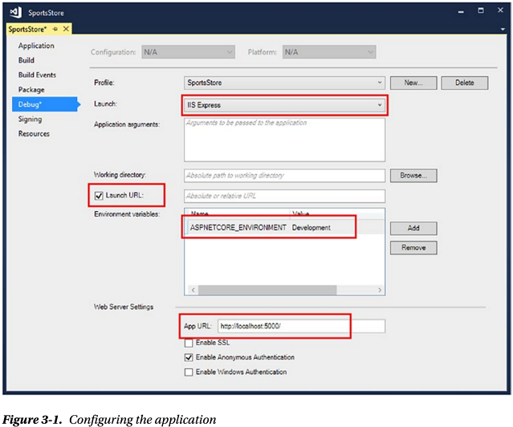
Figure 3-1

Slide 42
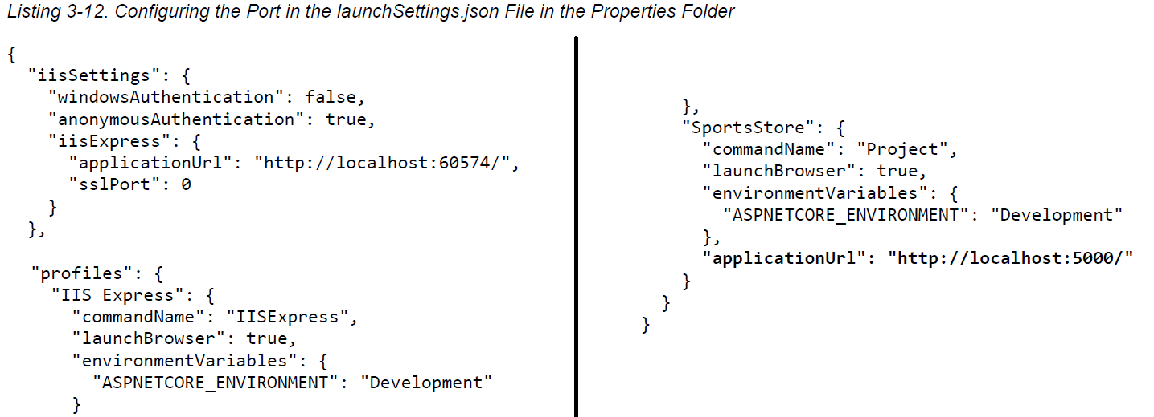
Listing 3-12

Slide 43
Creating and Editing the Configuration Files
Regardless of the IDE you are using, add a TypeScript file called boot.ts to the SportsStore/ClientApp folder, with the code shown in Listing 3-13.
This file is responsible for loading the Angular application and responding to changes to the client-side code.
Next, edit the Startup.cs file to change the code in the Configure method, as shown in Listing 3-14.
The additions enable the integration between the ASP.NET Core and Angular development tools.
Open the webpack.config.js file in the SportsStore folder, locate the module.exports statement shown in Listing 3-15, and make the changes in bold.
This file contains a lot of configuration statements and the ones you are looking for follow the long list of entries that deal with “rxjs” files.

Slide 44
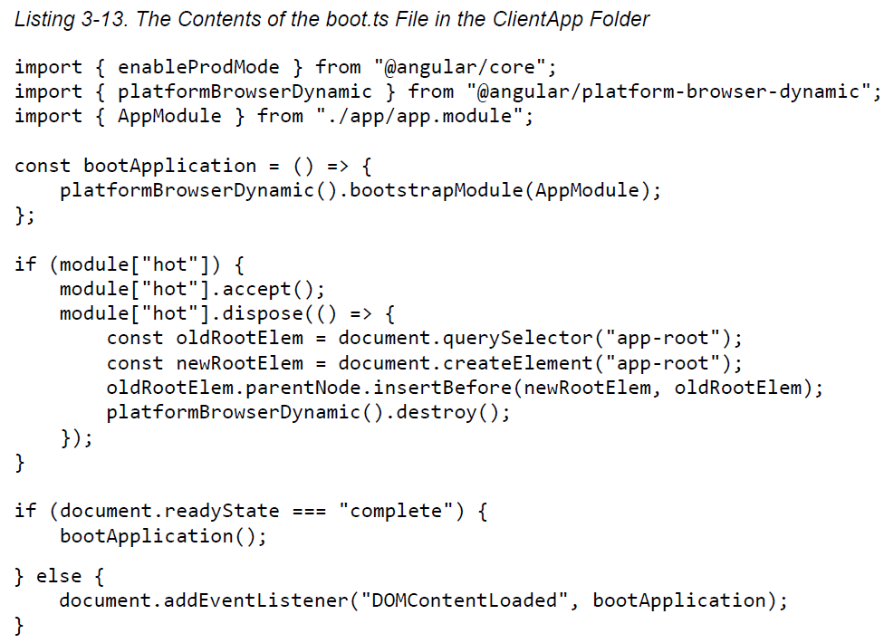
Listing 3-13

Slide 45
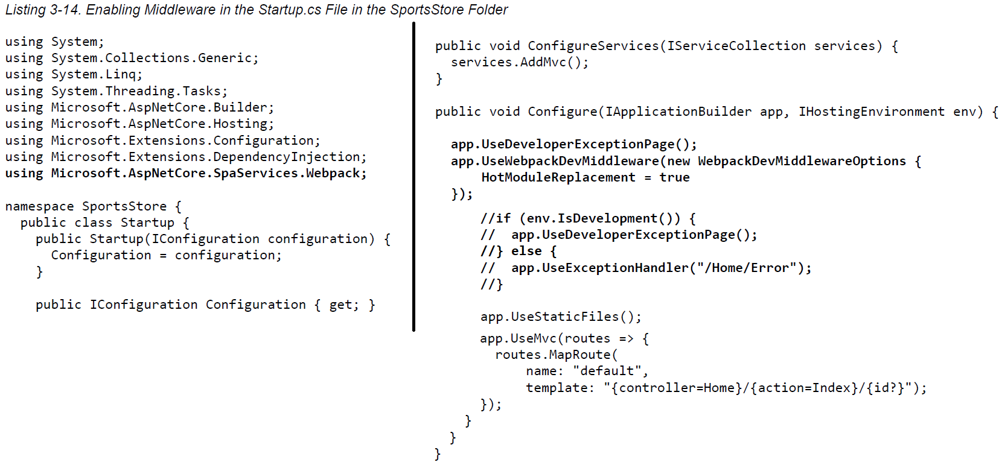
Listing 3-14

Slide 46
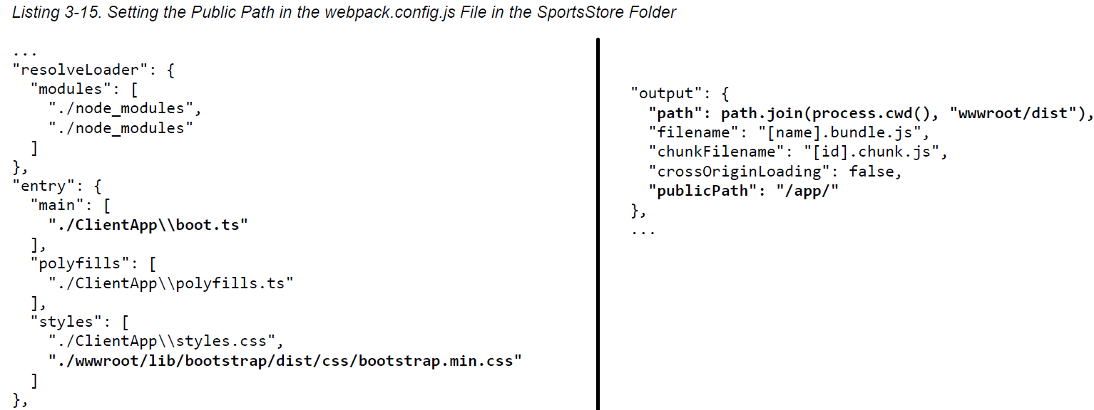
Listing 3-15

Slide 47
Enabling Logging Messages

Slide 48
Updating the Bootstrap Package

Slide 49
Removing Files

Slide 50
Updating the Controller, Layout, and View

Slide 51
Running the Project

Slide 52
Understanding the Combined Project and Tools

Slide 53
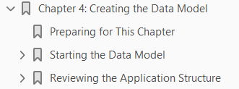
Creating the Data Model
4

Slide 54
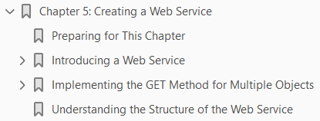
Creating a Web Service
5

Slide 55
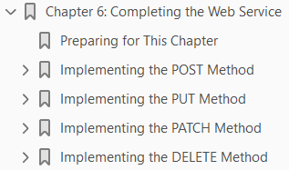
Completing the Web Service
6

Slide 56
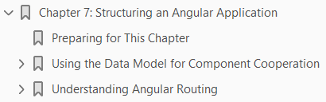
Structuring the Angular Application
7

Slide 57
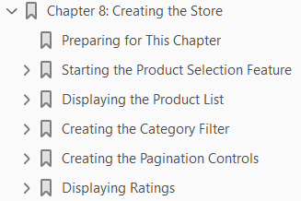
Creating the Store
8

Slide 58
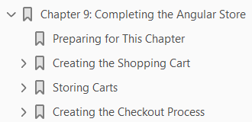
Completing the Angular Store
9

